Slide 1



Words War game
A Python Project for
Competitive Vocabulary Learning
Team Members
Mohammed Al-Buraq
Mohammed Al-Somali
Abdulrahman Bajunaid
Nawaf Alorabi
Tuwaiq Academy - 2026

Slide 2
ABOUT THE PROJECT
What is WORDS WAR GAME?
WORDS WAR GAME is a competitive educational game built using Python and Streamlit .
Players enter English words and compete based on rules.

Slide 3
PROJECT OBJECTIVE
The main goal of this project is to:
Apply Python concepts in a real project
Practice OOP (Object-Oriented Programming)
Build an interactive web application using Streamlit
Practice quick thinking and spelling skills

Slide 4
PROBLEM STATEMENT
Traditional vocabulary learning methods are:
Boring
Passive
Not interactive
Solution:
Turn vocabulary practice into a competitive word battle game.

Slide 5

PROJECT IDEA
A word-based battle game where:
Two players compete using English words of the same length
Words are validated using a real dictionary[WordFreq]
Words are translated into Arabic[deepTranslate]
Scores are calculated automatically
The winner is determined after each round

Slide 6
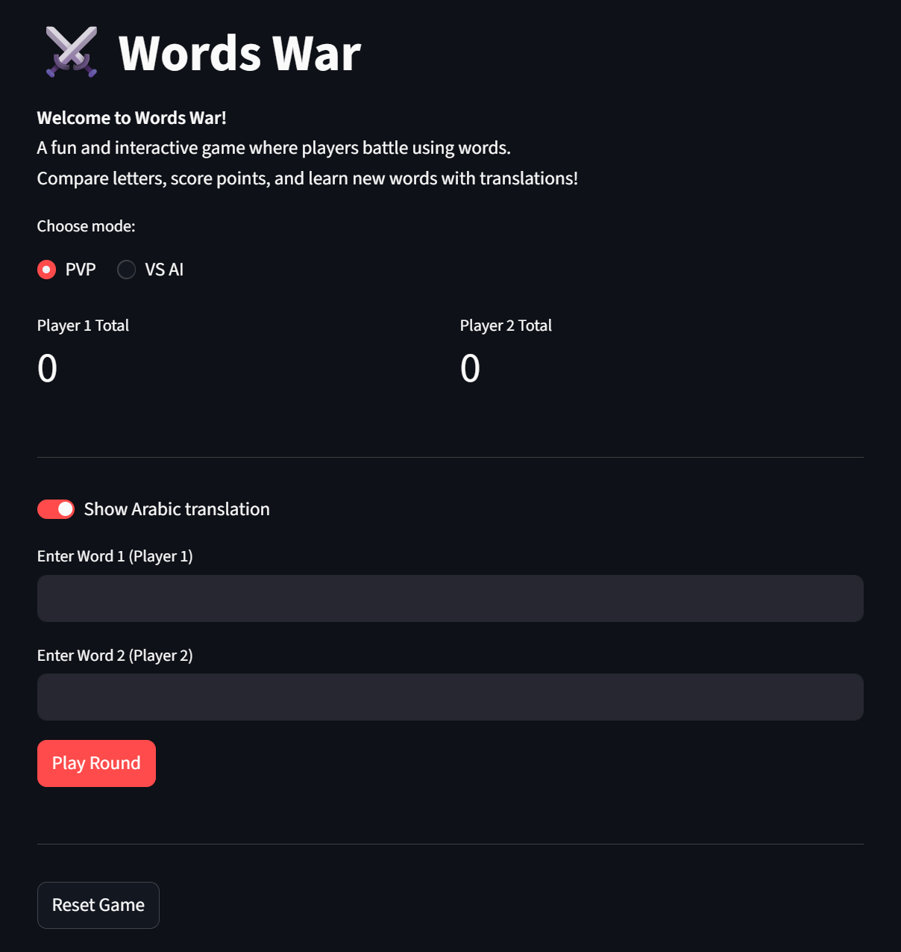
FEATURES
PvP & PvC game modes
Score tracking system
Fair word comparison logic
Automatic winner detection
Real-time score update after each round
OOP-based design

Slide 7
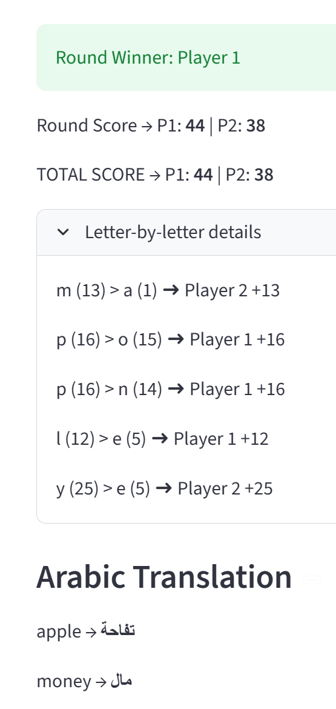
SCORING SYSTEM LOGIC
Each letter has a value:
a = 1
b = 2
c = 3
...
z = 26
P1 vs P2
money vs apple

Slide 8
TECHNOLOGIES USED
Python
Streamlit
WordFreq (lib)
Google Translator (lib)

Slide 9
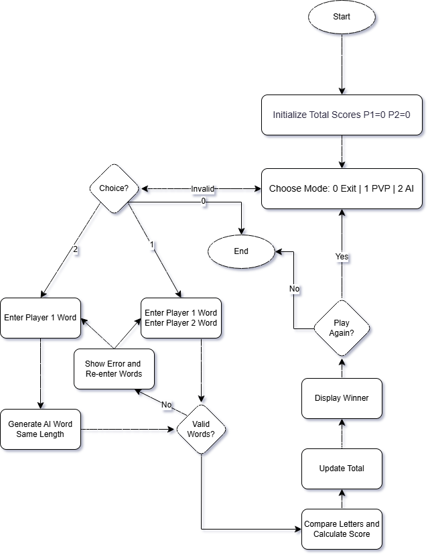
SYSTEM LOGIC
(FLOWCHART)

Slide 10
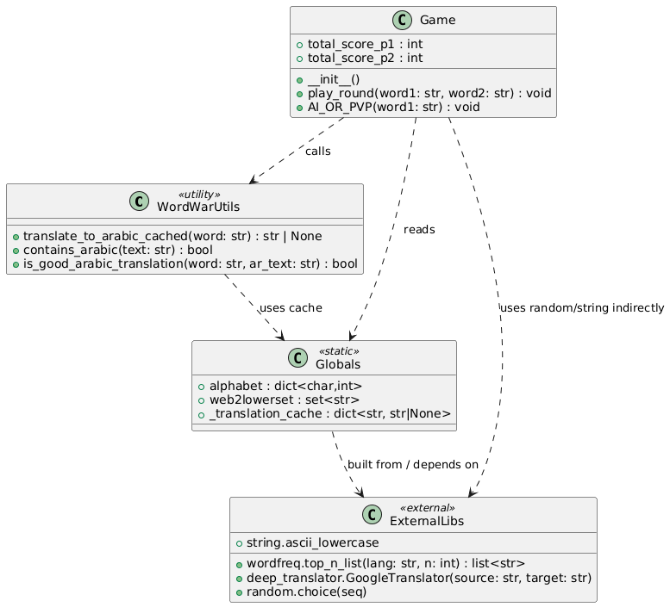
SYSTEM STRUCTURE
(CLASS DIAGRAM)

Slide 11
PROJECT EVALUATION
•The game logic works correctly for valid English words
•Score calculation is accurate and consistent
•Supports both Player vs Player and Computer modes
•Arabic translation is displayed successfully
•The application runs smoothly using Streamlit

Slide 12
CHALLENGES & SOLUTIONS
Handling invalid words → Using wordFreq dictionary validation
Generating random word with same length → Using wordfreq with google translation to validated the words
Handling complex Streamlit errors → Preventing common failures through input sanitization and controlled UI triggers.

Slide 13
WHAT WE LEARNED
Applying loops and conditions
Working with dictionaries and sets
Implementing OOP design
Building real web apps with Streamlit

Slide 14
FUTURE IMPROVEMENTS
Add difficulty levels
Online multiplayer mode
Leaderboard system

Slide 15
CONCLUSION
WE DEVELOPED AN INTERACTIVE WORD BATTLE GAME USING PYTHON AND STREAMLIT.
THE PROJECT APPLIES OOP CONCEPTS, WORD VALIDATION, AND SCORE CALCULATION.
IT MAKES LEARNING ENGLISH VOCABULARY FUN AND COMPETITIVE.
THIS PROJECT ENHANCED OUR SKILLS IN PROGRAMMING, LOGIC DESIGN, AND TEAMWORK.

Slide 16


THANK YOU
GITHUB
PLAY NOW

